Slide 1
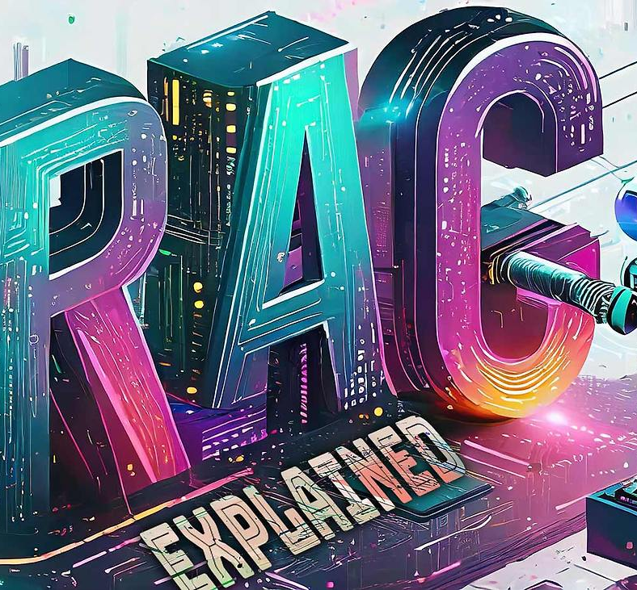
Case study analysis of the Retrieval Augmented Generation tool Verba
6253-ITAI-2372
Alfredo Garza, Richard Rodriguez, Olaleye Bakare, Khizar Khan
07-Jul-2025
This Photo by Unknown Author is licensed under CC BY

Slide 2
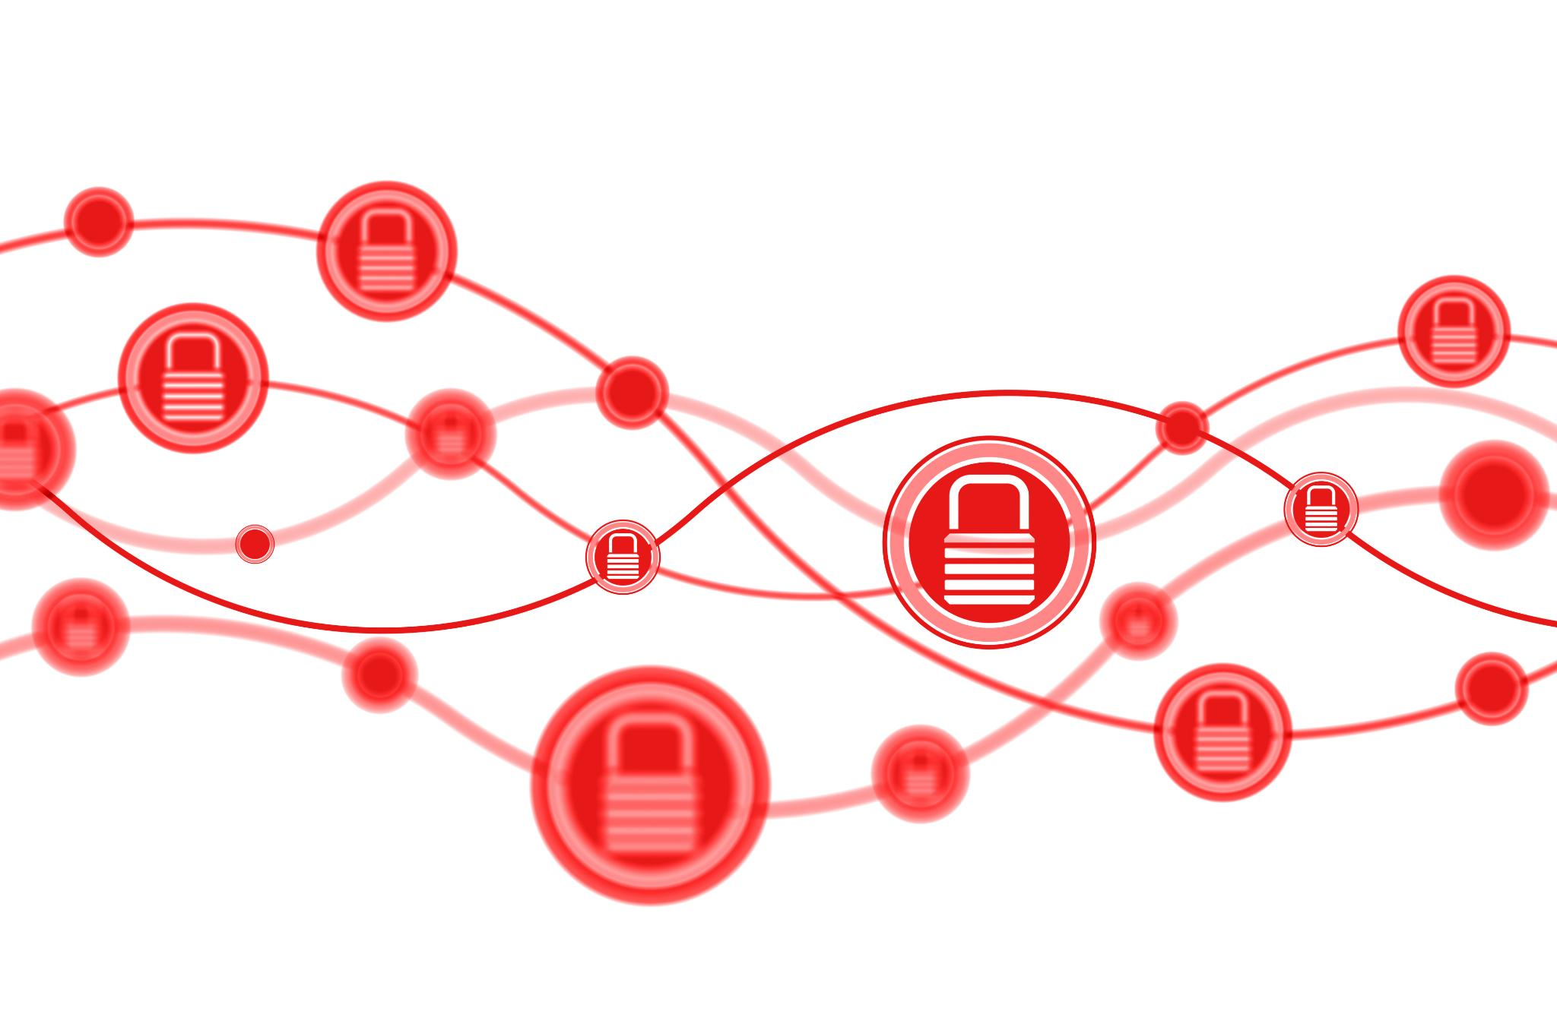
Understanding Tokenization
Definition of Tokenization
Tokenization involves breaking down text into tokens, which are the smallest units for text processing models.
Example of Tokenization
Example: 'Verba uses Weaviate for RAG' might be tokenized into: ['Ver', 'ba', 'uses', 'We', 'avi', 'ate', 'for', 'RAG'].
BPE-Based Tokenizer
Llama3 uses a BPE-based tokenizer to map tokens to numerical IDs, simplifying text processing for models.
Notes:
Tokenization is breaking down text into tokens like words or characters, which are the atomic units for models like Llama3. Example: The sentence 'Verba uses Weaviate for RAG' might be tokenized into: ['Ver', 'ba', 'uses', 'We', 'avi', 'ate', 'for', 'RAG']. Llama3 uses a BPE-based tokenizer that maps these tokens to numerical IDs.

Slide 3
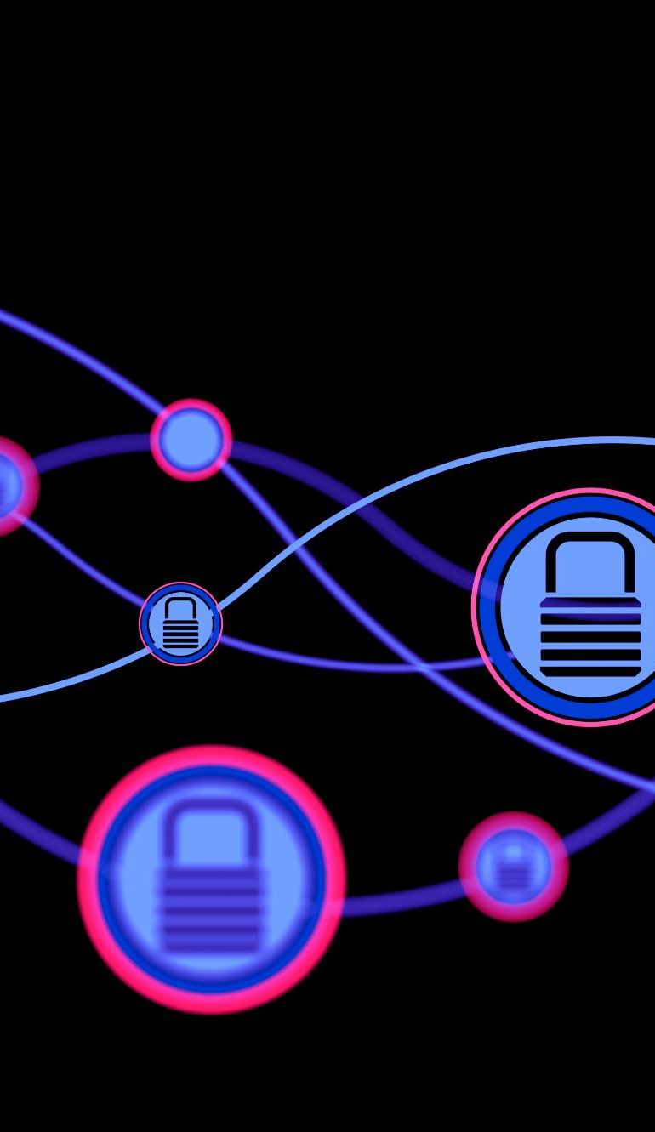
Importance of Tokenization
Embedding Precision
Tokenization ensures embedding precision by providing consistent and standardized input across various models.
Efficient Chunking
Token count determines chunk size, allowing for efficient data processing and management in NLP tasks.
Vector Storage Preparation
Tokenization prepares data for vector storage, shaping how meaning is captured and crystallized into embeddings.
Role in NLP Workflows
Tokenization plays a vital role in natural language processing workflows, impacting the accuracy and efficiency of models.
Notes:
Tokenization is crucial for embedding precision, ensuring consistent input across models. It enables efficient chunking, as token count determines size. Tokenization precedes vector storage, shaping how meaning is captured before it's crystallized into embeddings, playing a vital role in natural language processing workflows.

Slide 4
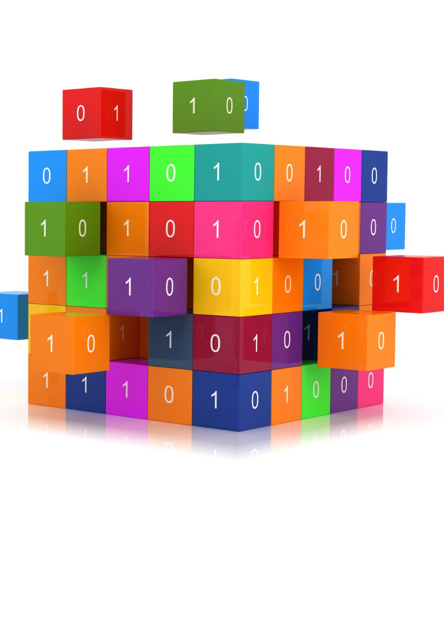
Role of Tokens in RAG
Token Embedding
Tokens are embedded into vector representations using models like mxbai-embed-large via Ollama for semantic processing.
Vector Storage in Weaviate
Embedded vectors are stored in Weaviate, enabling efficient semantic matching with user queries.
Token Re-tokenization
Retrieved chunks are re-tokenized and fed into Llama3 to generate coherent responses based on semantic search results.
Enabling Semantic Search
Tokens bridge raw text and model intelligence, facilitating accurate semantic search and response generation.
Notes:
Tokens are pivotal in the RAG pipeline, serving multiple roles. First, they are embedded into vector representations using models like mxbai-embed-large via Ollama. Then, these vectors are stored in Weaviate for semantic matching with queries. Finally, retrieved chunks are re-tokenized and passed to Llama3 for generating responses. Tokens bridge raw text and model intelligence, enabling semantic search and coherent generation.

Slide 5

Importance of Chunking
Manageable Segments
Chunking splits documents into manageable segments before tokenization and embedding, enhancing performance and relevance in language models.
Token Limit Management
Chunking helps manage Large Language Models' token limits, ensuring efficient handling of large documents.
Improved Retrieval Granularity
Smaller chunks improve retrieval granularity and reduce noise, leading to more precise and relevant search results.
Efficient Query Responses
Each chunk is embedded and stored separately, ensuring efficient and relevant responses to queries.
Notes:
Chunking splits documents into manageable segments before tokenization and embedding. It is vital for performance and relevance. Large Language Models (LLMs) have token limits which chunking helps manage. Smaller chunks improve retrieval granularity and reduce noise. Verba uses strategies like fixed-size and semantic-aware chunking. Each chunk is embedded and stored separately, ensuring efficient and relevant query responses.

Slide 6
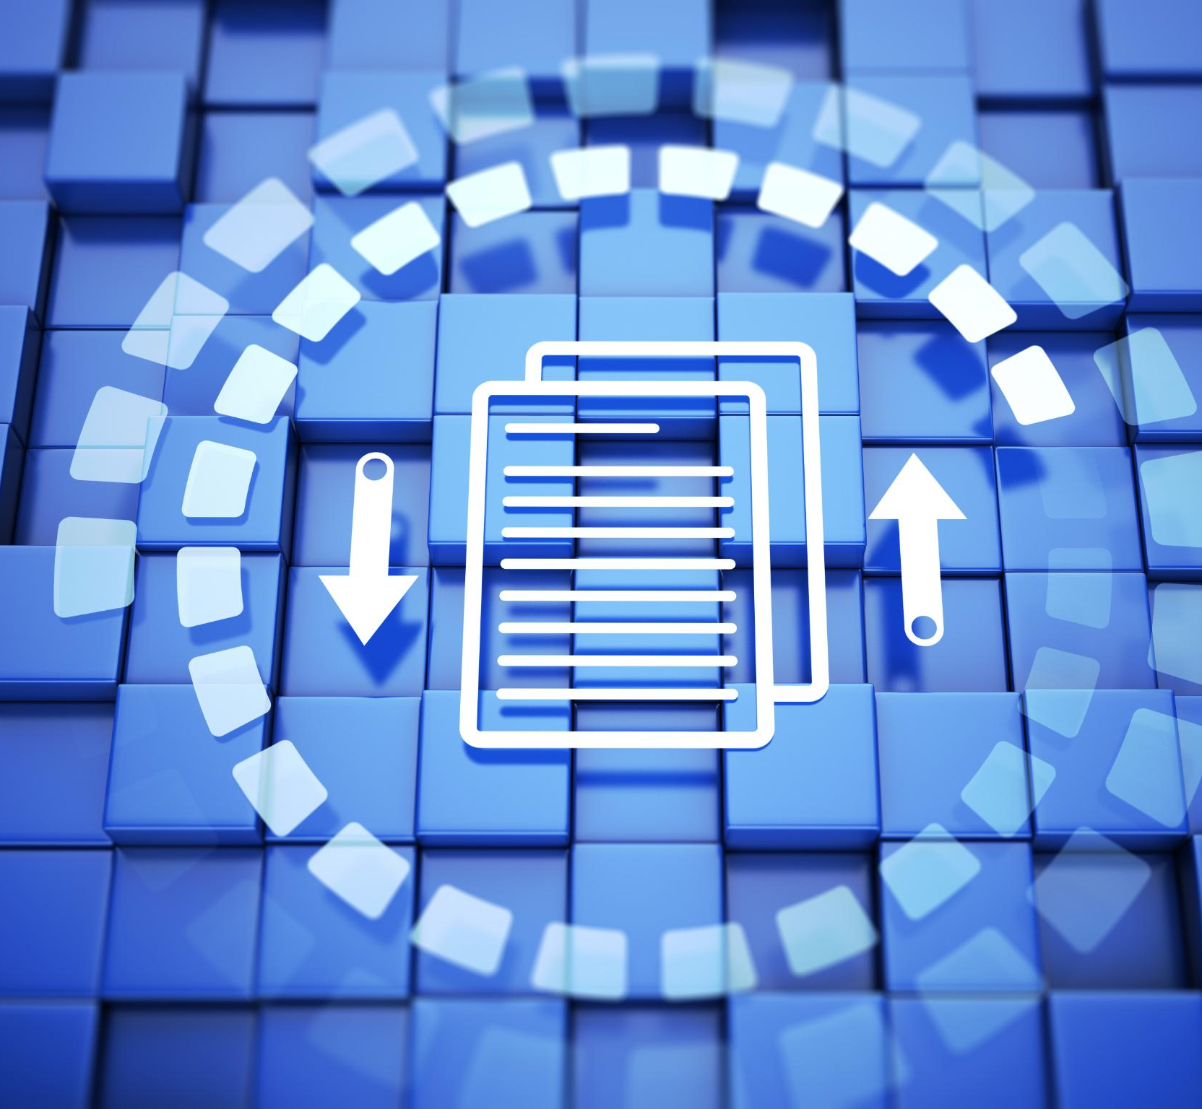
Real-World Flow Explained
Document Processing
Documents are ingested, chunked, tokenized, embedded, and stored in Weaviate for efficient retrieval and processing.
Query Comparison
User queries are tokenized, embedded, and compared to stored chunks to retrieve the most relevant information.
Response Generation
Retrieved chunks are re-tokenized and passed to Llama3, which employs BPE tokenization to generate efficient responses.
Notes:
In a simplified flow, documents are ingested, chunked, tokenized, embedded, and stored in Weaviate. User queries are then tokenized, embedded, and compared to stored chunks, retrieving top chunks. These chunks are re-tokenized and passed to Llama3, which generates a response. Llama3 employs an upgraded Byte Pair Encoding (BPE) tokenizer, enhancing efficiency and expressiveness.

Slide 7
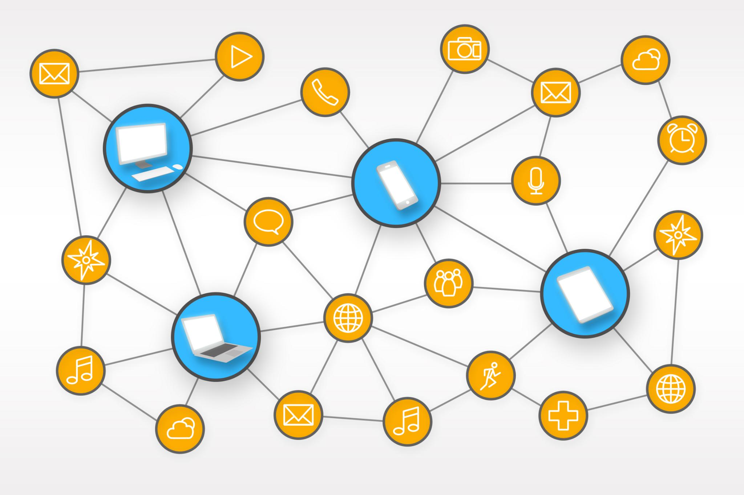
Llama3 Tokenizer Mechanics
BPE Tokenization Process
Llama3 uses BPE tokenization by splitting characters and merging frequent pairs to create subword units.
128,000-Token Vocabulary
The 128,000-token vocabulary efficiently represents common and rare patterns in Llama3.
Special Tokens for Formatting
Special tokens such as and are used for marking boundaries and prompt formatting.
Improved Compression
Llama3's improved compression reduces memory usage and speeds up inference, enhancing performance.
Notes:
Llama3 uses BPE tokenization, starting with character splitting and merging frequent pairs to build subword units. Its 128,000-token vocabulary compactly represents common and rare patterns. Special tokens like <|begin_of_text|> and <|end_of_text|> mark boundaries for prompt formatting. Improved compression reduces memory usage and speeds up inference.

Slide 8
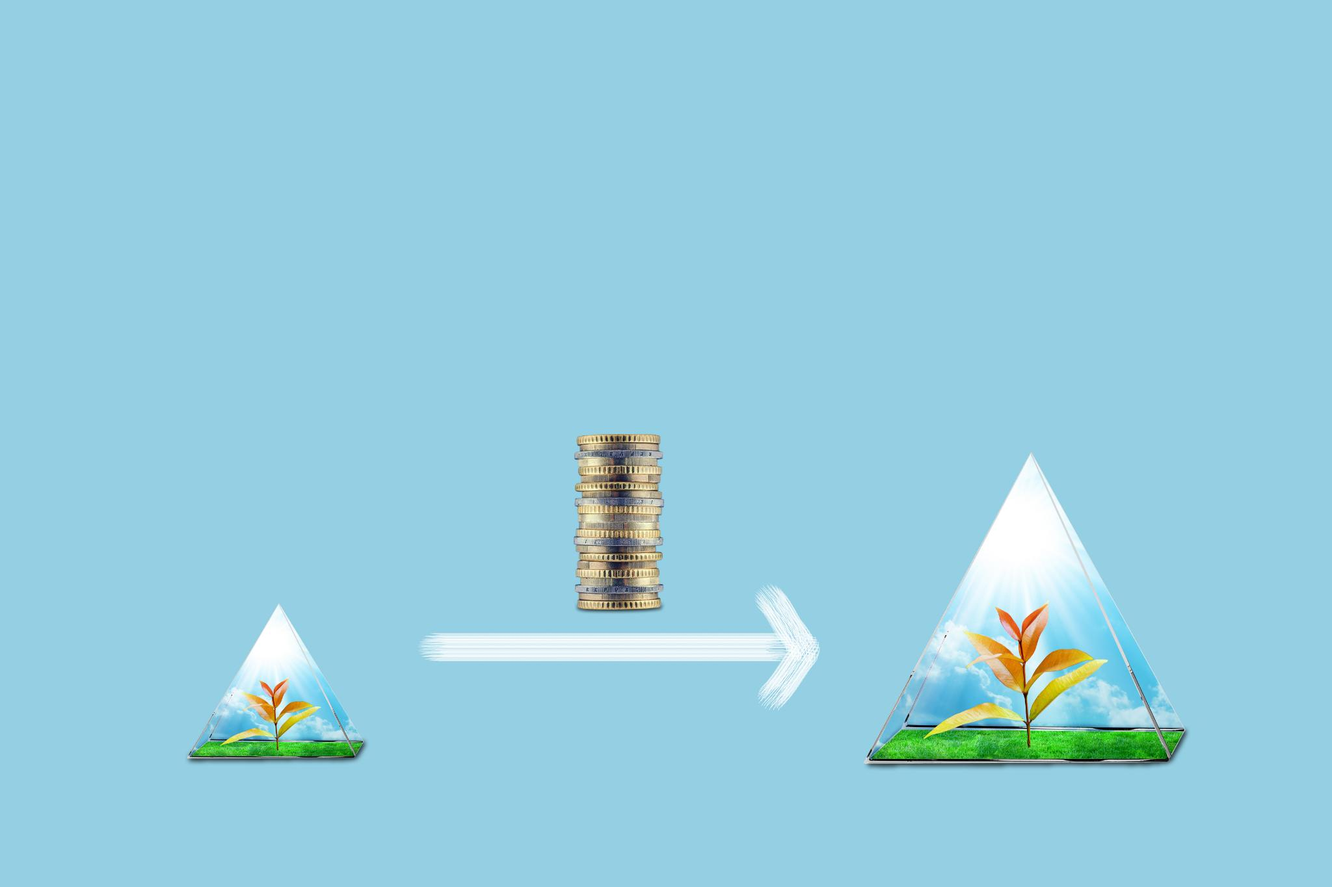
Why It Matters
Performance Improvement
Achieving better performance with fewer tokens leads to faster processing and lower compute costs.
Enhanced Accuracy
Nuanced tokenization improves understanding of complex inputs, especially in code, reasoning, and multilingual tasks.
Tokenizer Compatibility
The tokenizer is optimized for Llama3’s architecture and works seamlessly with models like Meta-Llama-3-8B-Instruct.
Notes:
Better performance is achieved with fewer tokens per input, leading to faster processing and lower compute costs. Enhanced accuracy is obtained through nuanced tokenization, improving understanding of complex inputs, especially in code, reasoning, and multilingual tasks. Compatibility is ensured as the tokenizer is optimized for Llama3’s transformer architecture, working seamlessly with models like Meta-Llama-3-8B-Instruct.

Slide 9
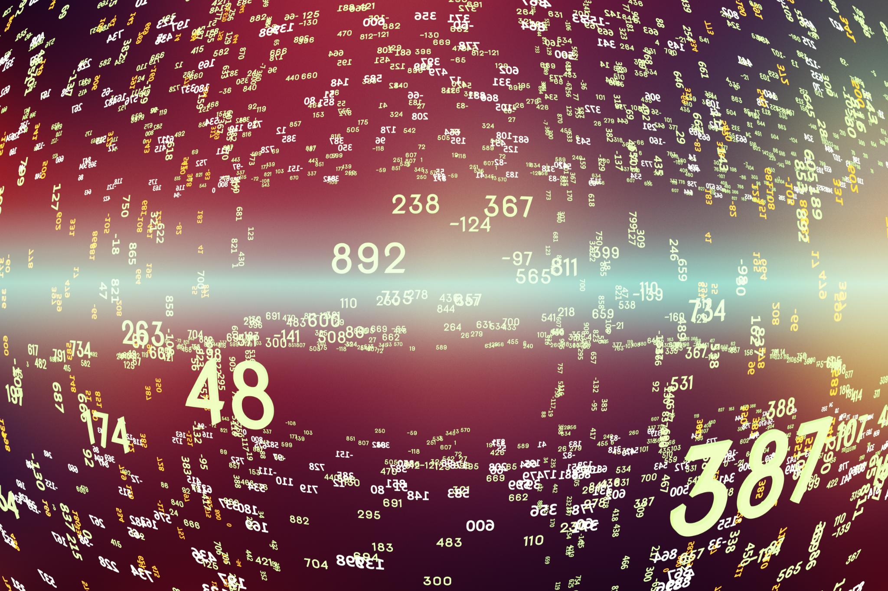
Understanding Vectors
Representation of Features
A vector is a list of numbers representing features or dimensions of data. Each number corresponds to a specific attribute.
Semantic Fingerprint
Vectors form a semantic fingerprint of an object, whether it's text, an image, or audio, for data analysis.
Pattern Recognition
Vectors are crucial for data analysis and pattern recognition in machine learning models.
Notes:
In machine learning, a vector is a list of numbers representing features or dimensions of data. Each number corresponds to a specific attribute, like 'topic', 'tone', or 'intent'. Vectors form a semantic fingerprint of an object, whether it's text, an image, or audio, and are crucial for data analysis and pattern recognition in ML models.

Slide 10
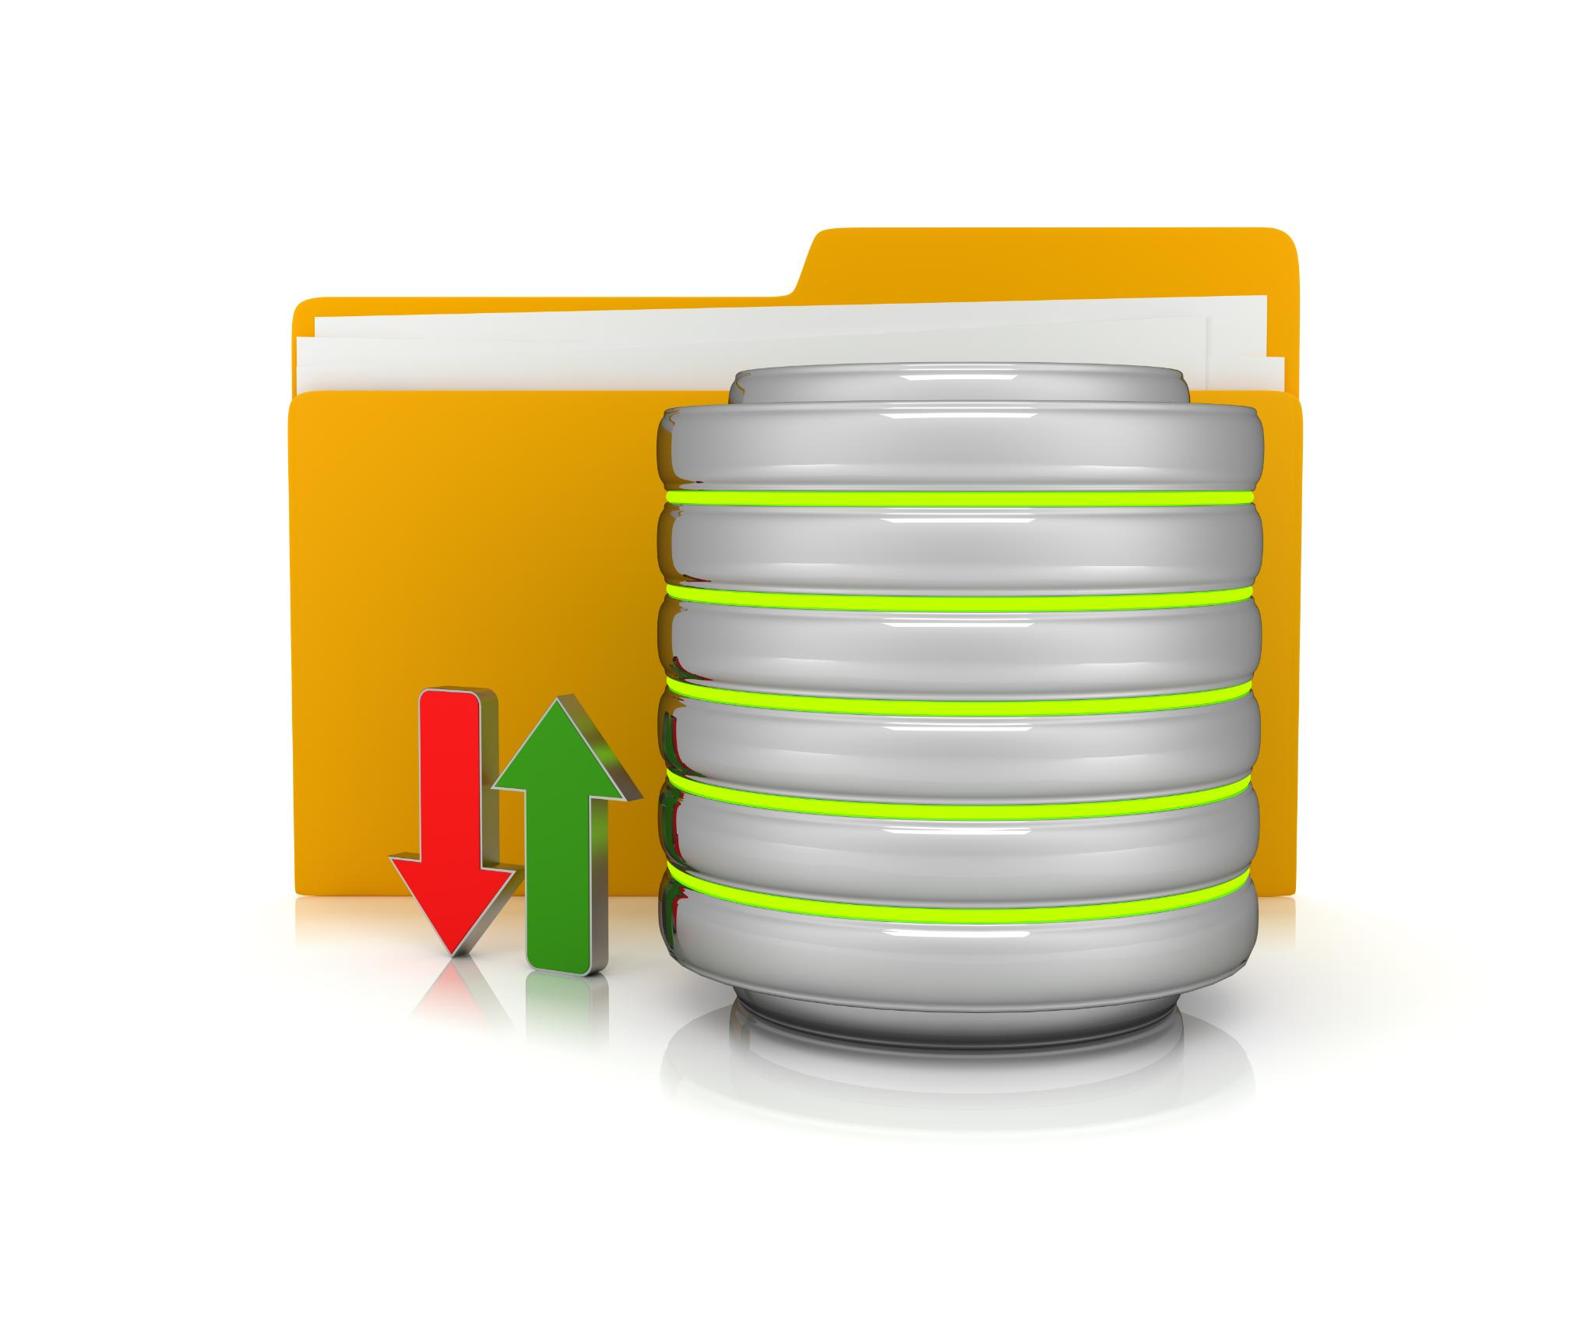
Using Vectors in Weaviate
Storing Vector Embeddings
Weaviate uses models like mxbai-embed-large to convert data into vectors for storage.
High-Speed Indexing
Vectors are stored in high-speed indexes such as HNSW to enable quick similarity searches.
Efficient Vector Searches
During querying, inputs are vectorized and compared to stored vectors for efficient searches.
Notes:
Weaviate is a vector database that stores data and their vector embeddings. When inserting an object, models like mxbai-embed-large convert it into vectors. These vectors are stored in a high-speed index such as HNSW for quick similarity searches. During querying, input is vectorized and compared to stored vectors, enabling efficient vector search or semantic search.

Slide 11
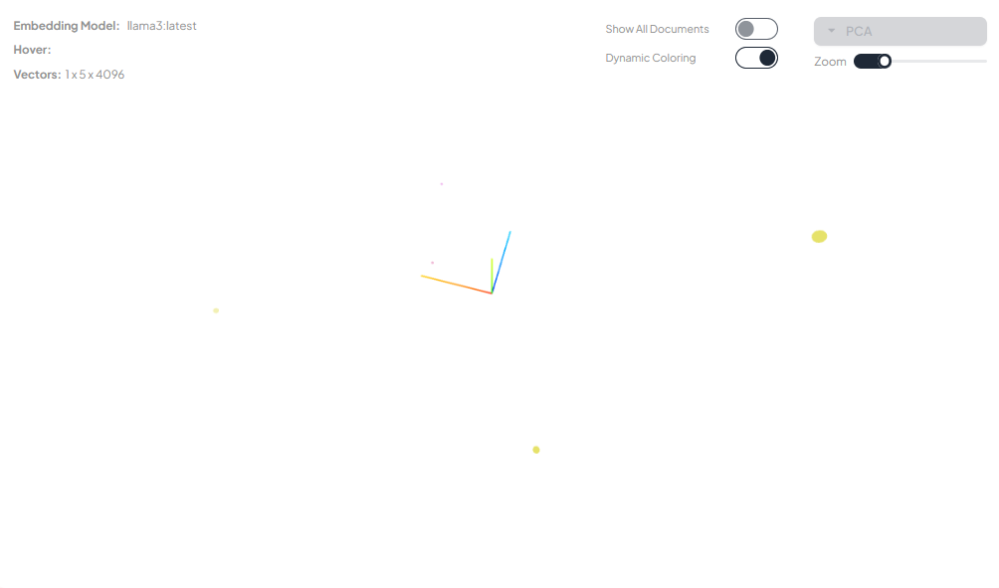
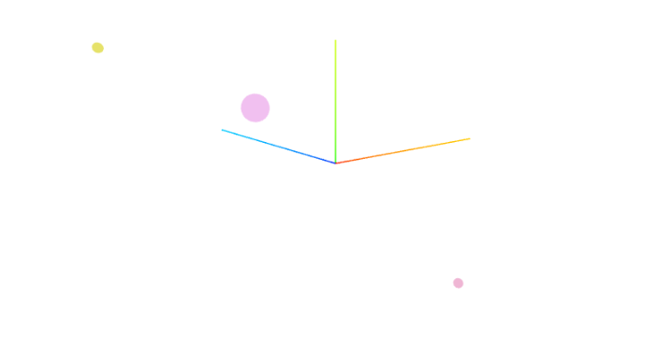
What Does a Vector “Look” Like?
Multi-Dimensional Space
Vectors represent data points in a multi-dimensional space, allowing for complex and detailed data representation.
Embedding Models
Embedding models generate vectors that represent data, such as Jeopardy-style questions, in high-dimensional spaces.
Complex Data Relationships
Models process these vectors to understand complex data relationships and work with multi-dimensional data.
Using Verba we are building a pipeline where:
1. Text → Tokenized → Embedded → Stored as vector
2. Query → Embedded → Compared → Relevant chunks retrieved
Notes:
Vectors represent data in multi-dimensional space. For example, a Jeopardy-style question about the liver may be represented by a 768 or 1024-dimensional vector. These vectors are generated by embedding models and cannot be interpreted directly. Instead, the model processes them to understand and work with complex data relationships.

Slide 12
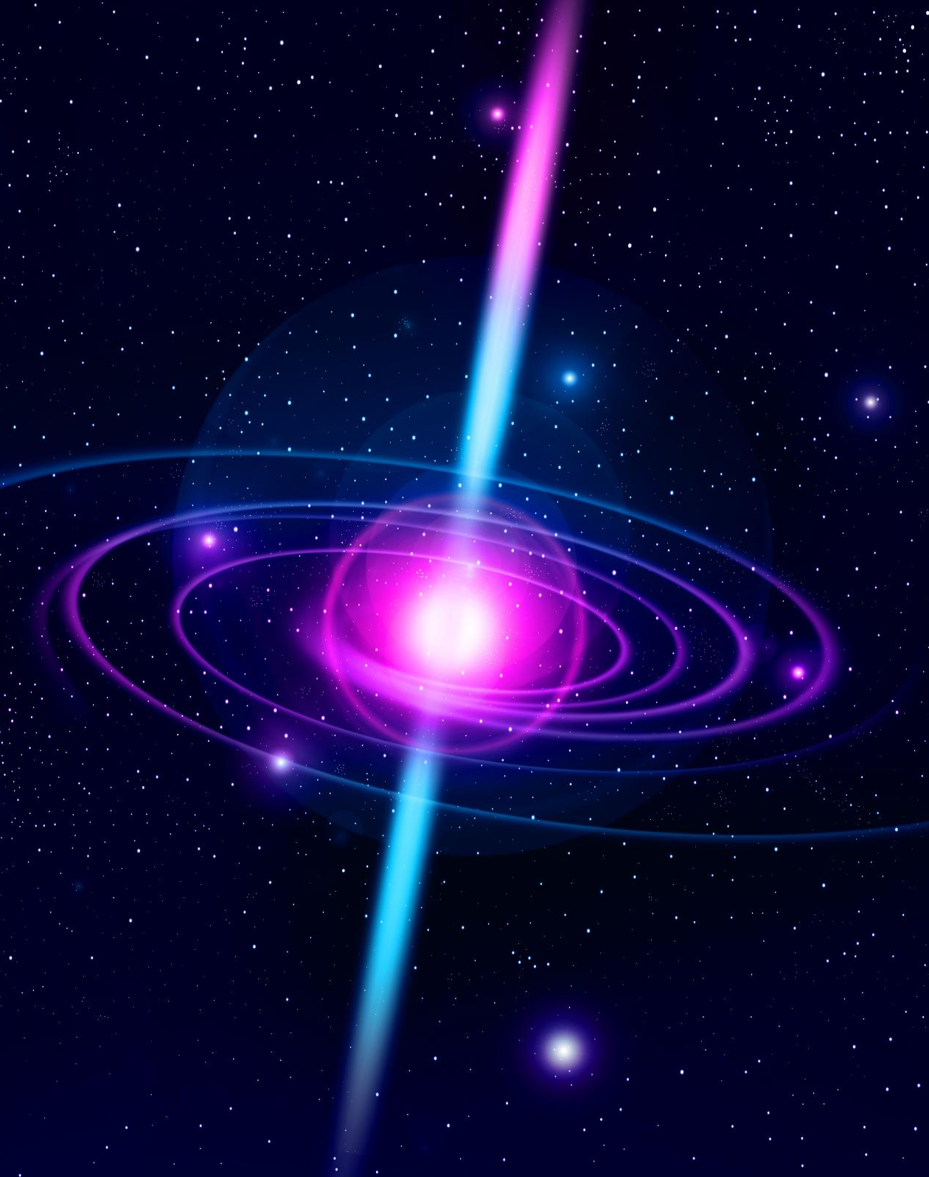
Why It Matters
Precision in Vector Space
Vectors capture meaning beyond keywords, making related terms, like “car” and “automobile,” close in vector space.
Speed with ANN Indexing
Weaviate employs Approximate Nearest Neighbor (ANN) indexing to search through millions of vectors in milliseconds.
Flexibility with Vectorizers
Weaviate allows the use of built-in or custom vectorizers, enabling multiple named vectors per object for diverse semantic views.
Notes:
Precision: Vectors capture meaning beyond keywords, making “car” and “automobile” close in vector space. Speed: Weaviate uses Approximate Nearest Neighbor (ANN) indexing to search millions of vectors in milliseconds. Flexibility: Weaviate allows the use of built-in vectorizers or custom ones, enabling multiple named vectors per object for diverse semantic views.

Slide 13
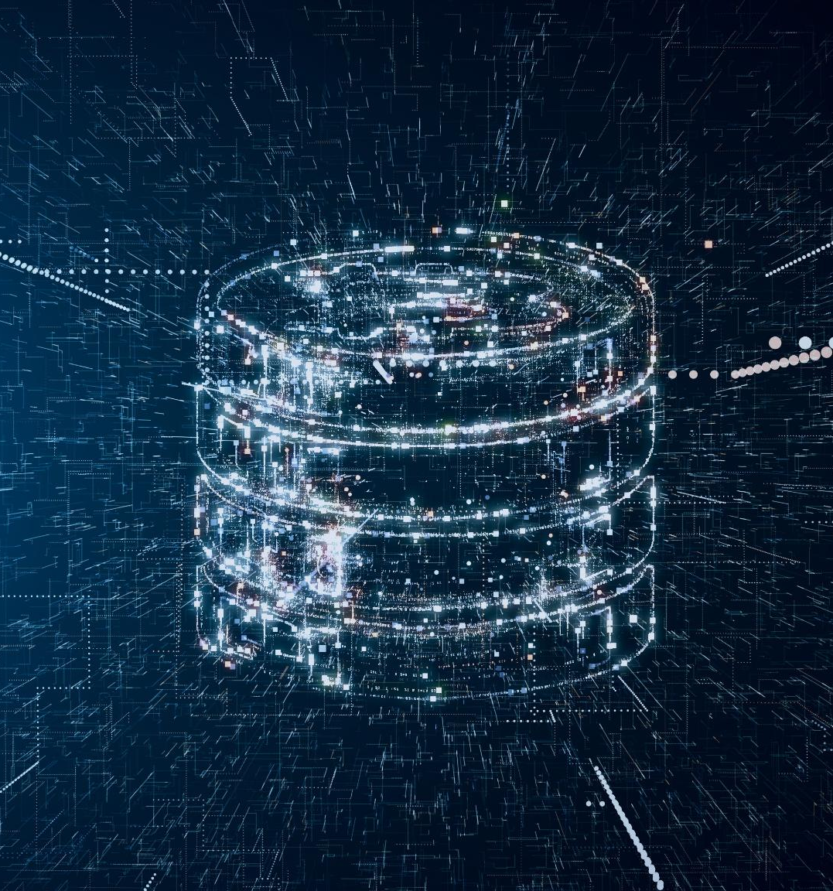
Vector Databases vs. Tokenized Data
Text Tokenization
Raw text is tokenized for processing by embedding models, splitting text into smaller units of meaning.
Embedding Conversion
Tokens are converted into high-dimensional vectors by embedding models, representing the text's meaning.
Vector Storage in Weaviate
Vectors are stored in Weaviate with metadata, allowing fast similarity searches using ANN algorithms.
Notes:
Vector databases like Weaviate store embedded representations of data, not tokenized data. The process involves text input, tokenization, embedding, and storage. Raw text is tokenized for processing by embedding models, which convert tokens into high-dimensional vectors representing the text's meaning. These vectors are stored in Weaviate with metadata, enabling fast similarity searches using ANN algorithms.

Slide 14
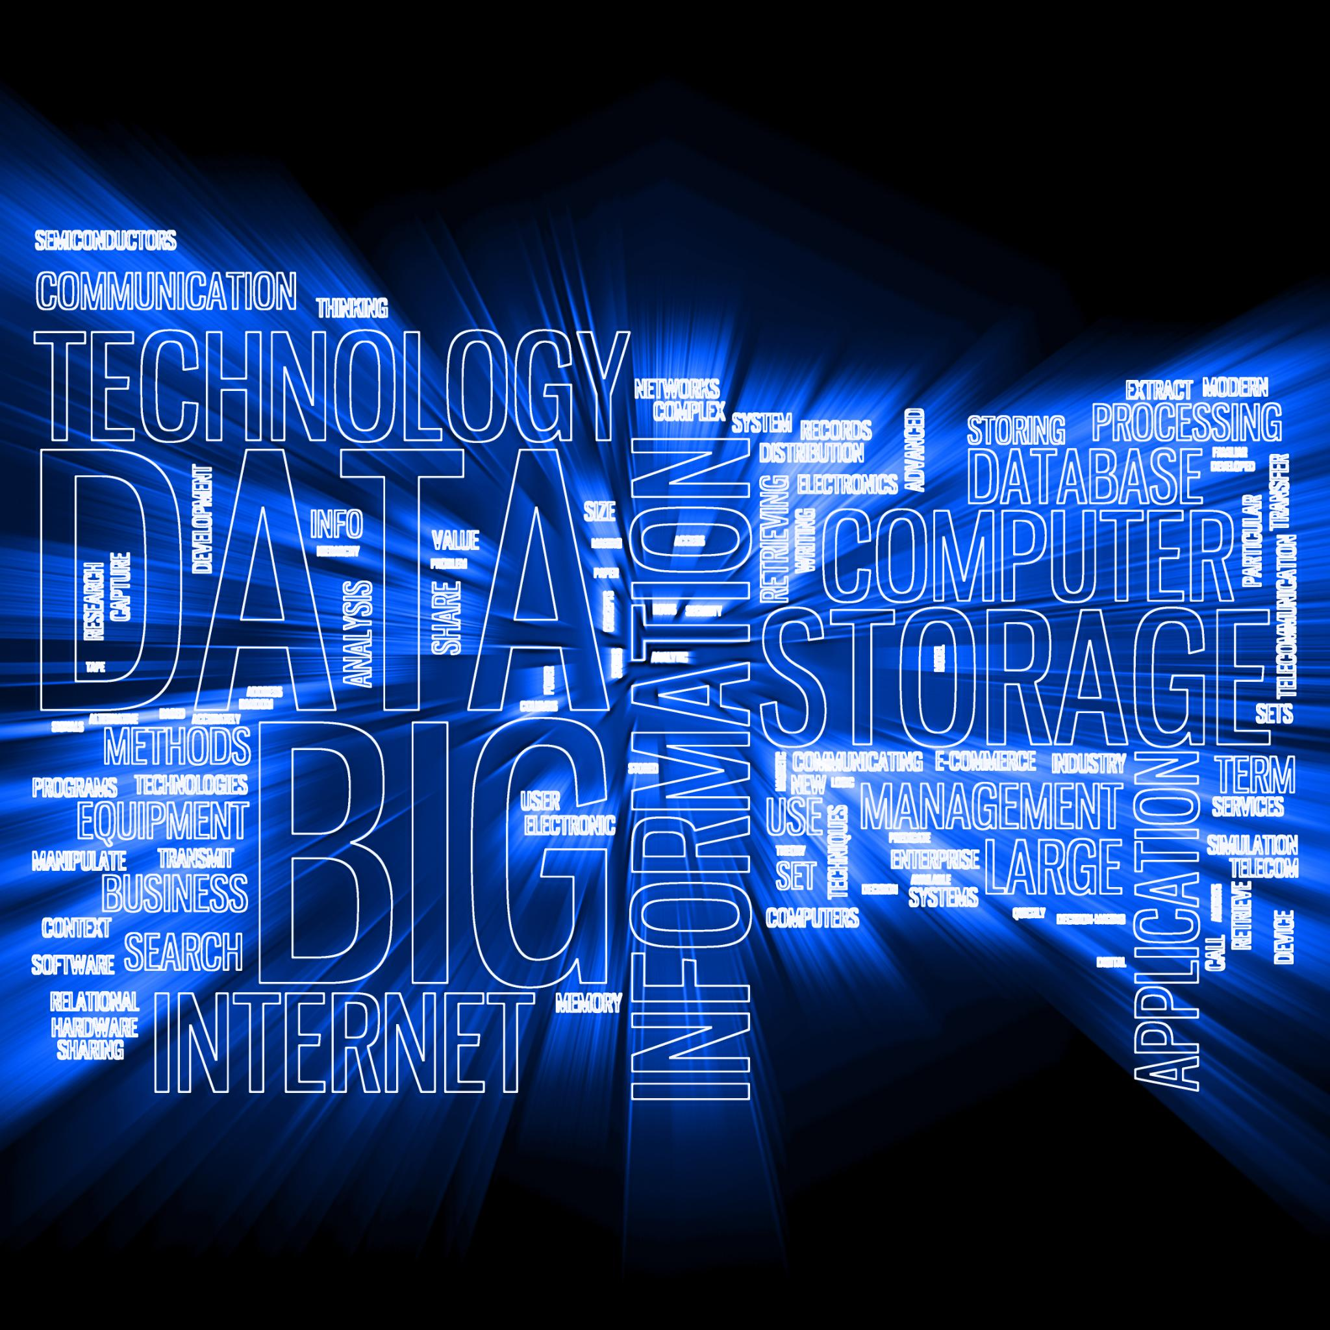
Weaviate Data Storage
Optional Raw Text Storage
Weaviate can optionally store raw text used for retrieval or output purposes in data management.
Embeddings for Semantic Search
Embeddings are stored in Weaviate and utilized for effective semantic search capabilities.
Metadata Storage and Utilization
Metadata is stored in Weaviate and used for filters, categories, and other organizational needs.
Notes:
Weaviate stores various components for efficient data management. Raw text can be stored optionally and is used for retrieval or output purposes. Tokens are not stored directly in Weaviate. Embeddings are stored and utilized for semantic search. Metadata is also stored and used for filters, categories, and other organizational needs.

Slide 15
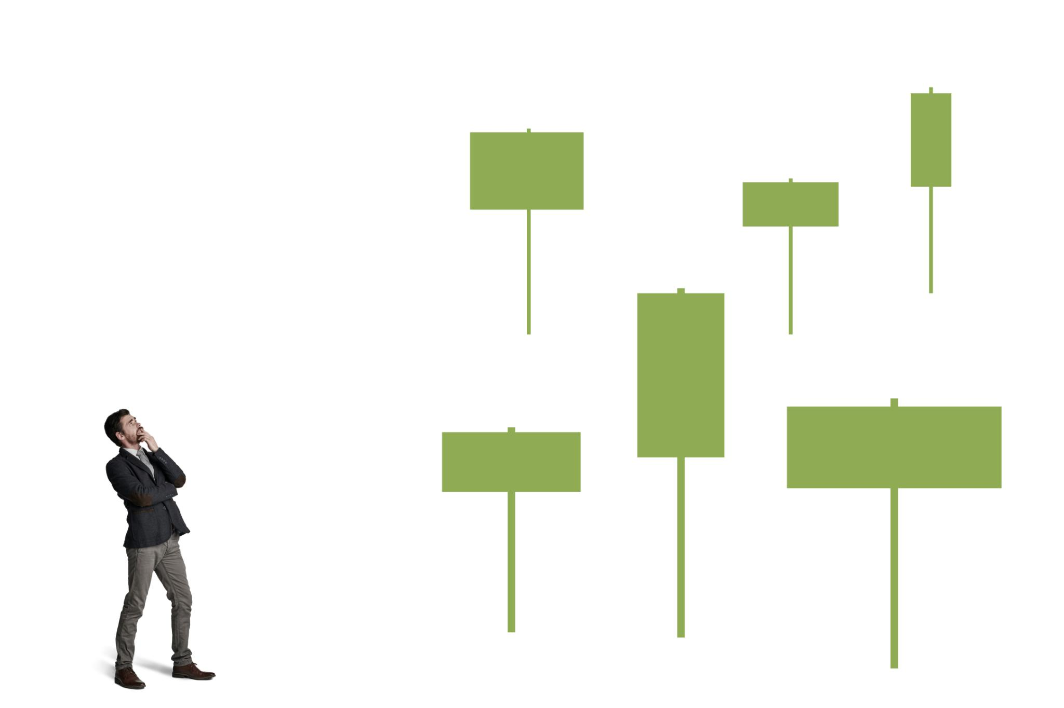
Conventional Indexes
Exact-Match Queries
Conventional indexes are designed for exact-match queries, providing very fast search speeds for deterministic data retrieval.
Range Queries
Indexes like B-trees are ideal for range queries, allowing efficient searching of structured data such as numbers or dates.
Indexing Methods
Common indexing methods include B-trees, hash tables, and inverted indexes, each tailored to specific query types and structured data.
Limitations in Semantic Similarity
Conventional indexes cannot handle semantic similarity, treating related terms like 'car' and 'automobile' as unrelated.
Notes:
Conventional indexes are used in relational or document databases for exact-match or range queries. They are often built using B-trees, hash tables, or inverted indexes. Ideal for structured data like numbers, dates, or keywords, they provide very fast search speeds for deterministic queries. However, they can't handle semantic similarity, treating terms like 'car' and 'automobile' as unrelated.

Slide 16
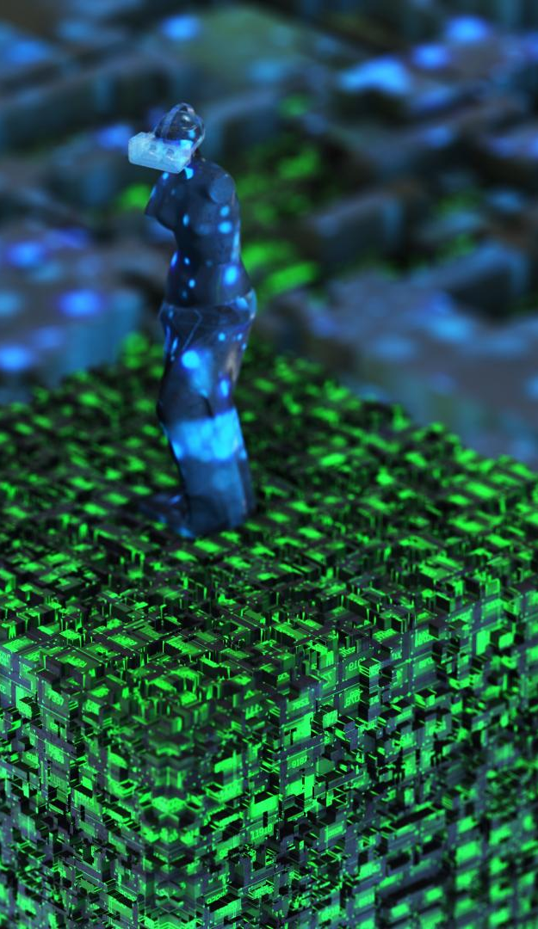
Understanding Vector Indexes
Similarity Search
Vector indexes are vital for similarity search in vector databases, enabling efficient search across high-dimensional embeddings.
Key Algorithms
Algorithms like HNSW, IVF, and LSH structure the data, making vector indexes essential for AI applications with unstructured data.
Approximate Nearest Neighbor
ANN search helps find semantically close items in vector indexes, optimizing AI applications for text, images, and audio.
Speed vs. Accuracy Tradeoff
Different algorithms offer a speed versus accuracy tradeoff, which can be tuned based on the specific requirements of AI applications.
Notes:
Vector indexes are crucial in vector databases for similarity search across high-dimensional embeddings. They use algorithms like HNSW, IVF, or LSH to structure data. Ideal for AI applications with unstructured data like text, images, or audio. They employ Approximate Nearest Neighbor (ANN) search to find semantically close items. There is a speed vs. accuracy tradeoff which can be tuned based on the algorithm chosen.

Slide 17
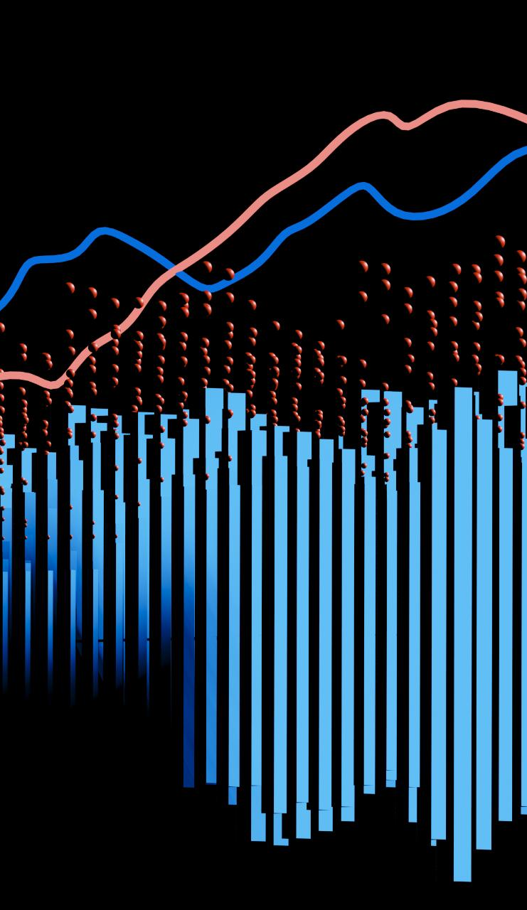
Vector vs. Conventional Indexes
Conventional: Like searching for a specific term in a dictionary.
Vector (Verba): Like asking a research librarian to find "anything about AI in entertainment" and getting nuanced results that match ideas, not just terms.
Notes:
Vector indexes and conventional indexes differ significantly in RAG workflows. Conventional indexes use keyword-based exact matches suitable for structured data with B-trees, inverted indexes, and hash maps. They excel in speed and accuracy for known fields. Vector indexes like Verba in RAG work with semantic similarity across embeddings, handling unstructured data with HNSW, IVF-PQ, and ANN algorithms. They offer conceptual understanding and flexibility for open-ended queries.

Slide 18
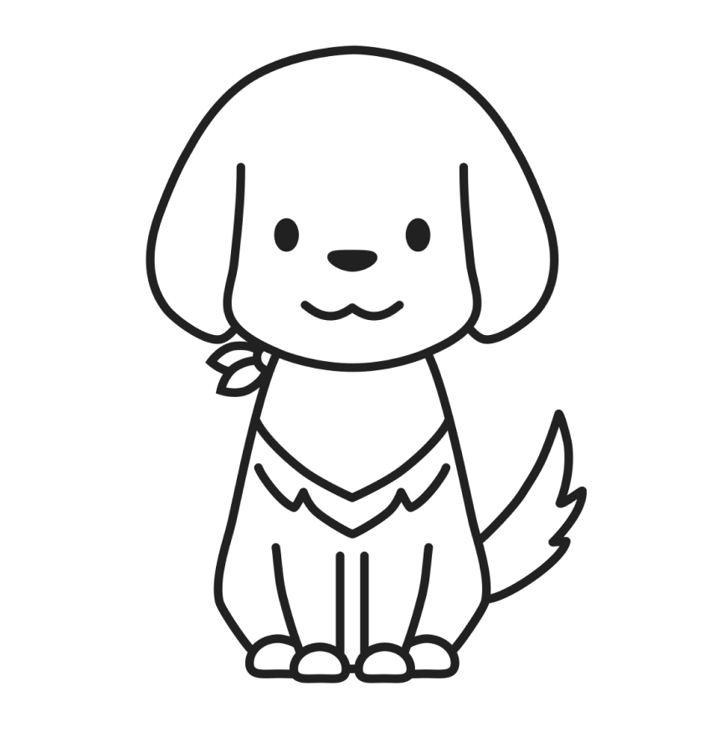
Verba RAG Architecture
Manager Overview
The Manager oversees the entire workflow within the Verba RAG Architecture, ensuring smooth operation and integration of modules.
ReaderManager Function
ReaderManager parses input data into VerbaDocument objects, which are foundational for further processing in the architecture.
ChunkerManager Role
ChunkerManager segments documents into semantic chunks, facilitating more precise analysis and processing.
Embedding and Retrieval
EmbeddingManager embeds chunks in Weaviate and handles retrieval processes, ensuring efficient data access.
RetrieveManager and Generation
RetrieveManager identifies relevant chunks, while GenerationManager synthesizes responses based on retrieved data, enhancing modular intelligence.
BatchManager Utility
BatchManager manages large file uploads via batching, optimizing the handling of extensive data sets.
Notes:
The Verba RAG Architecture is designed for modular intelligence. Key components include: Manager, which oversees workflows; ReaderManager, parsing input into VerbaDocument objects; ChunkerManager, segmenting documents into semantic chunks; EmbeddingManager, embedding chunks in Weaviate and handling retrieval; RetrieveManager, identifying relevant chunks; GenerationManager, synthesizing responses; and BatchManager, managing large file uploads via batching.

Slide 19
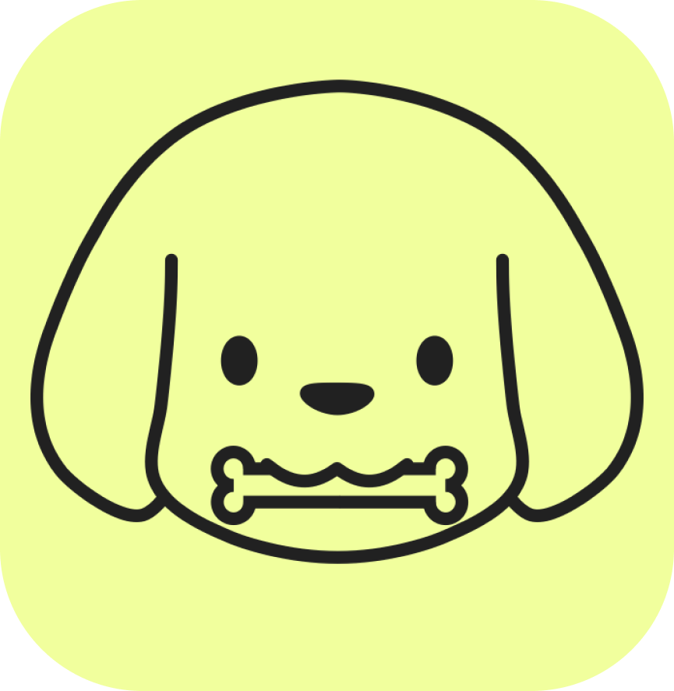
Verba RAG Application Stack
Frontend:
Next.JS web application is used for user interface for char, data upload, and results display.
Backend:
FASTAPI server handles API requests, orchestrate RAG pipeline and data flow management
Vector Database:
Weaviate serves as the vector database used for storing and searching document embeddings.
LLMs and Embeddings:
HuggingFace is used for local embedding models and Ollama for local LLM interface. OpenAI, Cohere, Groq, Novita Ai, Upstage and Antropic can be used cloud based LLMs and embeddings
Data ingestion and Chunking:
Data from PDFs, DOCX, CSV/XLSX, Github/Gitlab, web scraping and audio transcription can be loaded and chunking techniques that are token-based, sentence-based, semantic, recursive can be run.
Orchestration and Deployment:
Docker is supported for reproducible deployment, Kubernetes is supported for scalable and production setups. Pip can be used for installation of verba with install goldenverba
Notes:
Verba is open-source RAG application designed to allow data query, and interaction with data using AI models. Front end can be customizable to run locally or deployed in cloud. The backend stack is set up to handle API requests, orchestrate retrieval augmented generation (RAG). Weaviate supports hybrid search like semantic with keyword, filtering and metadata management. Ollama such as Llama 3, Mistral, Phil are used as local LLM interface and HuggingFace is used for local embedding models. OpenAI, Cohere, Anthropic, Grq, Novita AI, Upstage are cloud based LLMs and embeddings.

Slide 20

Verba Local Application Stack
Vector vl Indexes
VLOCAL VERBA RAG STACK. Conventional Indexes
Frontend: Next. js
Backend: FAST API
Vector Database: Weaviate (embedded or Docket))
LLMs and Embeddings: Olama such as Llama 3
Data ingestion and Chunking: Ollama or HuggingFace
Orchestration and Deployment: Docker Compose or PIP
Notes:
Verba is open-source RAG application designed to allow data query, and interaction with data using AI models. Front end can be customizable to run locally or deployed in cloud. The backend stack is set up to handle API requests, orchestrate retrieval augmented generation (RAG). Weaviate supports hybrid search like semantic with keyword, filtering and metadata management. Ollama such as Llama 3, Mistral, Phil are used as local LLM interface and HuggingFace is used for local embedding models. OpenAI, Cohere, Anthropic, Grq, Novita AI, Upstage are cloud based LLMs and embeddings.

Slide 21

Verba Cloud Application Stack
Vector vl Indexes
VCLOUD/HYBRID RAG STACK. Conventional Indexes
Frontend: Next. js
Backend: FAST API
Vector Database: Weaviate
LLMs and Embeddings: OpenAI, Cohere, Anthropic
Data ingestion and Chunking: OpenAI, Cohere
Orchestration and Deployment: Docker, Kubernetes or PIP
Notes:
Verba is open-source RAG application designed to allow data query, and interaction with data using AI models. Front end can be customizable to run locally or deployed in cloud. The backend stack is set up to handle API requests, orchestrate retrieval augmented generation (RAG). Weaviate supports hybrid search like semantic with keyword, filtering and metadata management. Ollama such as Llama 3, Mistral, Phil are used as local LLM interface and HuggingFace is used for local embedding models. OpenAI, Cohere, Anthropic, Grq, Novita AI, Upstage are cloud based LLMs and embeddings.

Slide 22

Verba Custom Application Stack
Vector vl Indexes
VCUSTOM/ENTERPRISE RAG STACK. Conventional Indexes
Frontend: Custom Next.js or integrated into existing user interface
Backend: FAST API with custom endpoints or integrations
Vector Database: Weaviate , Pinecone, Qdrant
LLMs and Embeddings: Any supported provider
Data ingestion and Chunking: Any supported provider
Orchestration and Deployment: Docker Swarm, Kubernetes or other
Notes:
Verba is open-source RAG application designed to allow data query, and interaction with data using AI models. Front end can be customizable to run locally or deployed in cloud. The backend stack is set up to handle API requests, orchestrate retrieval augmented generation (RAG). Weaviate supports hybrid search like semantic with keyword, filtering and metadata management. Ollama such as Llama 3, Mistral, Phil are used as local LLM interface and HuggingFace is used for local embedding models. OpenAI, Cohere, Anthropic, Grq, Novita AI, Upstage are cloud based LLMs and embeddings.

Slide 23

Verba Deployment Options
Install via Pip
Run 'pip install goldenverba' to easily install Verba using Python's package manager.
Build from Source
Clone the repository and run 'pip install -e .' to build Verba from its source code.
Deploy Using Docker
Clone the repository and use Docker by executing 'docker compose --env-file up -d --build'.
Python Requirements
Ensure Python version >=3.10.0 and <3.13.0
Our focus is on Docker as there are limitations with the current Python based deployment and using Weviate Database on a Windows OS.
Notes:
You have three deployment options for Verba: Install via pip by running 'pip install goldenverba'. Build from source by cloning the repository and running 'pip install -e .'. Use Docker for deployment by cloning the repository and executing 'docker compose --env-file <your-env-file> up -d --build'. Ensure Python >=3.10.0,<3.13.0 is installed if not using Docker.

Slide 24

Ollama: Meta's Llama 3
Llama 3 Family
Ollama is part of the advanced Llama 3 family of models developed by Meta Inc.
Model Sizes
Llama 3 models come in 8B and 70B parameter sizes, catering to different computational needs.
Instruction-Tuned Version
The instruction-tuned version is optimized for dialogue and chat applications.
Superior Chat Capabilities
This model outperforms many open-source chat models on common benchmarks, providing superior conversational capabilities.
Notes:
Ollama is part of the Llama 3 family of models from Meta Inc. These state-of-the-art models come in 8B and 70B parameter sizes, available as pre-trained or instruction-tuned versions. We use the instruction-tuned model, optimized for dialogue and chat applications. It outperforms many open-source chat models on common benchmarks, providing superior conversational capabilities.

Slide 25
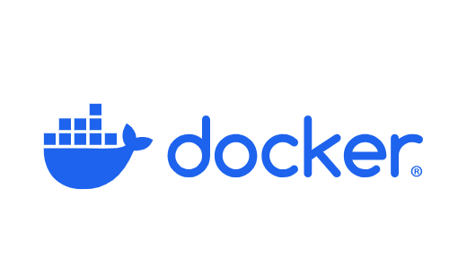
Dockerization
Process of packaging an application and all its dependencies into a standardized unit called a Docker container.
Docker is a software platform that simplifies the process of building, running, managing and distributing applications using containers.
It is developed by Docker Incorporation
It is open source
It virtualizes the host operating system using the same kernel
Applications run in containers as isolated environments
2 types of Docker editions: docker-CE and dokcer-EE
Notes:
Dockerization is the process of packaging application and all its dependencies (libraries , frameworks, configuration files etc. into standardized unit called container. It is an open source platform that can virtualize the host operating system using kernel. Applications run in containers as isolated environments. It runs in linux kernel such as ubuntu, apache etc. It can community edition which is free and enterprise edition which is paid for.

Slide 26
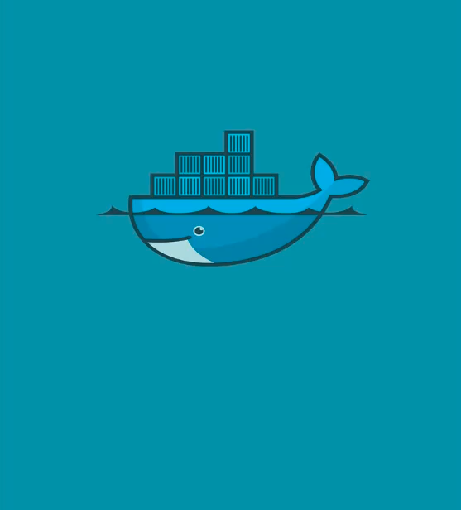
Importance of Dockerization
Consistency: Ensures application runs consistently across different environments.
Isolation : Isolates applications rom each other and from the underlying host system.
Portability: Docker container can run on any machine with Docker installed.
Efficiency: Runs faster to start than traditional virtual machines.
Scalability: Docker containers can be scaled up or down.
Development environment: Developers can set up development environments quickly.
Notes:
Dockerization simplifies entire software lifecycles from development and testing to deployment and scaling by providing consistent, isolated, and portable environment for applications. Tools like docker swarm or Kubernetes can orchestrate many containers across multiple machines. Applications run smoothly across different environments (development, testing, staging, production) because container includes all dependencies eliminating “working on my machine” issue.

Slide 27

Docker & WSL Overview
Docker Containerization
Docker automates application deployment by packaging applications with dependencies into containers, ensuring consistency across environments.
Container Benefits
Containers are lightweight, portable, and self-sufficient, aiding faster code shipping and standardized operations.
WSL Compatibility Layer
WSL, developed by Microsoft, provides a full Linux environment on Windows without needing a VM or dual-boot setup.
Notes:
Docker is an open-source platform that automates application deployment using containerization. It packages applications with dependencies into containers, ensuring consistency across environments. Containers are lightweight, portable, and self-sufficient, aiding faster code shipping and standardized operations. WSL, developed by Microsoft, is a compatibility layer enabling a full Linux environment on Windows without needing a VM or dual-boot setup.

Slide 28
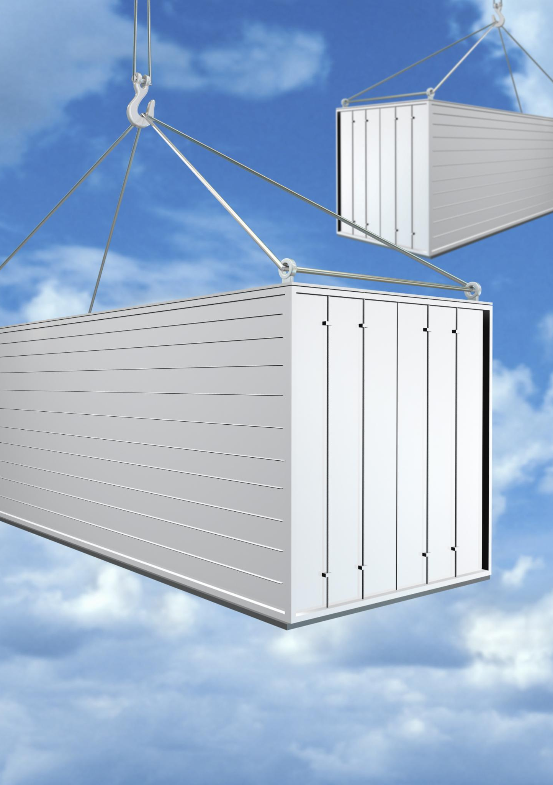
Cloud Docker Tools - AWS
Amazon ECS
Amazon ECS offers fully managed container orchestration, providing scalable and reliable environments for running Docker containers.
Amazon EKS
Amazon EKS provides complex Kubernetes orchestration, enabling seamless management and deployment of containerized applications.
Amazon ECR
Amazon ECR offers secure storage for Docker images, facilitating safe and efficient image management within the AWS ecosystem.
Notes:
Cloud-based Docker management tools provide scalable, managed environments for running containers. AWS offers several key services: Amazon ECS for fully managed container orchestration, Amazon EKS for complex Kubernetes orchestration, and Amazon ECR for secure Docker image storage. These tools are ideal for production-grade applications requiring autoscaling, IAM integration, and strong coupling with the AWS ecosystem.

Slide 29
Cloud Docker Tools – MS Azure
Azure Kubernetes Service
AKS offers managed Kubernetes with deep Azure DevOps integration, ensuring scalable, efficient container orchestration.
Azure Container Instances
ACI provides lightweight, serverless container hosting, removing the need for managing infrastructure.
Azure Container Registry
ACR stores and manages Docker images, facilitating CI/CD pipelines and hybrid cloud configurations for enterprise applications.
Notes:
Azure provides scalable, managed environments for running containers without infrastructure worries. Azure Kubernetes Service (AKS) offers managed Kubernetes with deep Azure DevOps integration. Azure Container Instances (ACI) provide lightweight, serverless container hosting. Azure Container Registry (ACR) stores and manages Docker images. These tools are ideal for enterprise apps with CI/CD pipelines and hybrid cloud needs.

Slide 30
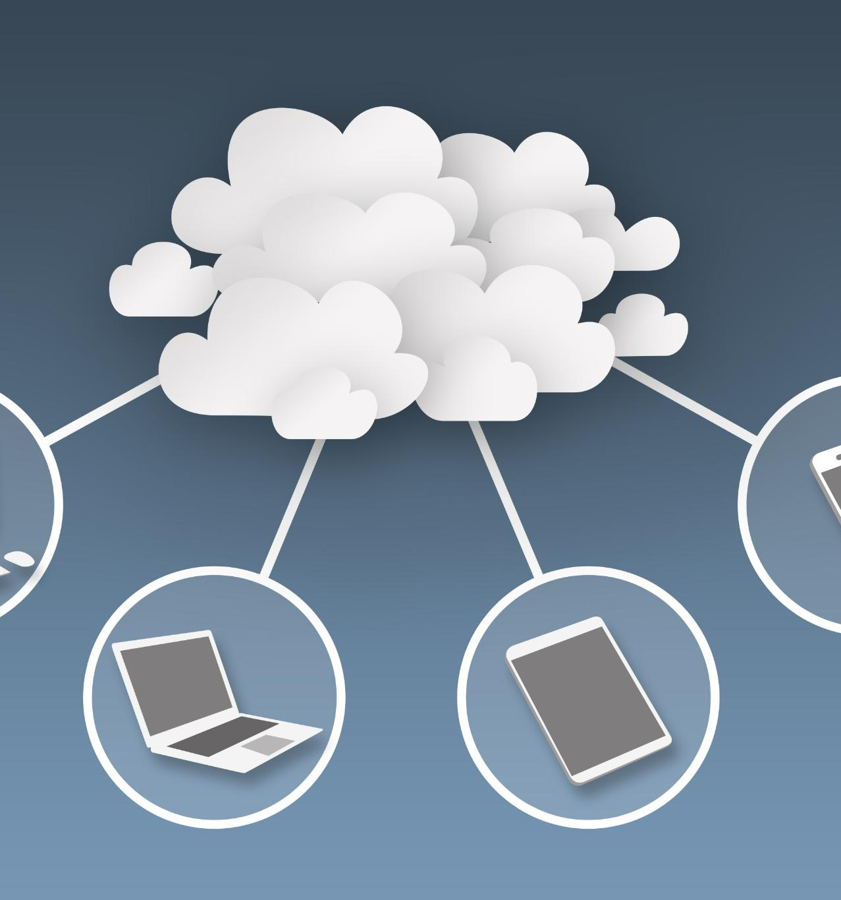
Cloud Docker Tools –Google Cloud
Google Kubernetes Engine (GKE)
GKE provides highly scalable Kubernetes with automated upgrades and monitoring, ideal for managing containerized applications.
Cloud Run
Cloud Run is a serverless platform designed for stateless Docker containers, enabling rapid, scalable deployment.
Artifact Registry
Artifact Registry securely stores Docker images and other artifacts, facilitating reliable and safe distribution of container images.
Notes:
Google Cloud offers scalable, managed environments for running containers. Google Kubernetes Engine (GKE) provides highly scalable Kubernetes with automated upgrades and monitoring. Cloud Run is a serverless platform for stateless Docker containers. Artifact Registry stores Docker images and other artifacts securely. These tools are ideal for microservices and event-driven architectures with fast deployment cycles.

Slide 31
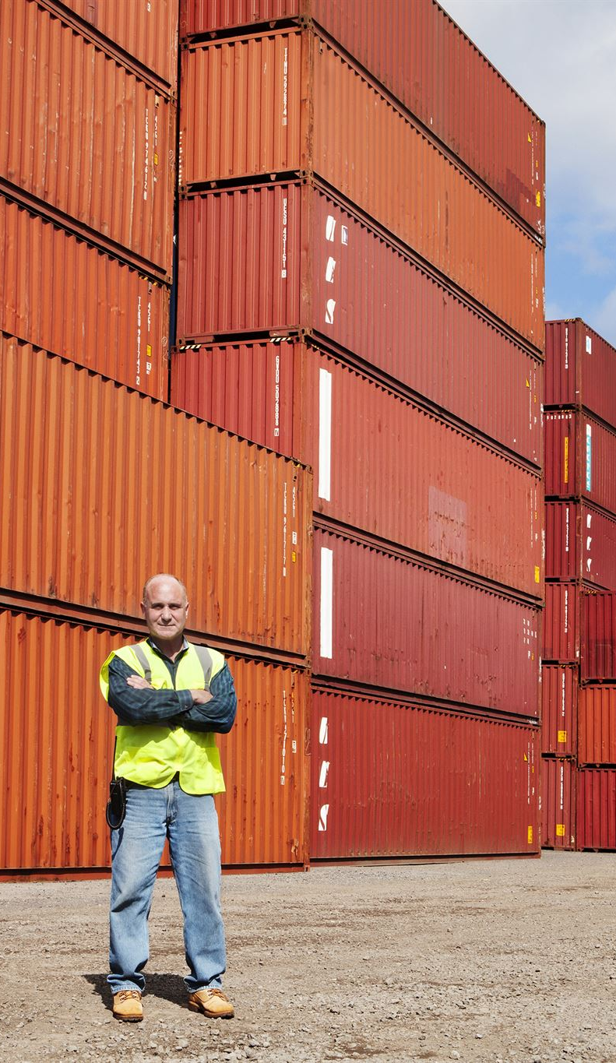
Running Docker Locally
Speed and Simplicity
Running Docker locally offers speed and simplicity with no cloud latency, making it ideal for quick iterations.
Cost-Efficient
Using Docker locally avoids cloud billing, providing a cost-efficient solution for development and testing environments.
Customizable Control
Running Docker locally gives customizable control over networking and resources, tailoring to specific environment needs.
Limitations in Scalability
Local Docker setup has limited scalability for high-availability workloads, requiring manual maintenance and orchestration tools.
Notes:
Running Docker locally provides full control over your environment, ideal for development, testing, and lightweight deployments. Pros: Speed & simplicity with no cloud latency, cost-efficient without cloud billing, and customizable control over networking and resources. Cons: Limited scalability for high-availability workloads, manual maintenance, and lack of native autoscaling requiring orchestration tools.

Slide 32

References:
Geh, R. L., Zhang, H., Ahmed, K., Wang, B., & Van den Broeck, G. (2025, June 26). The impact of tokenization methods on language models. Simple Science. https://scisimple.com/en/articles/2025-06-26-the-impact-of-tokenization-methods-on-language-models--a3z2j85
APXML. (n.d.). Effect of tokenization on perplexity. In How to build a large language model (Chapter 21). https://apxml.com/courses/how-to-build-a-large-language-model/chapter-21-intrinsic-evaluation-metrics/effect-tokenization-perplexity
Hudson, M. (2024, February 29). Retrieving “adjacent” chunks for better context [Forum post]. Weaviate Community Forum. https://forum.weaviate.io/t/retrieving-adjacent-chunks-for-better-context/1603
Theja, R. (2023, October 5). Evaluating the ideal chunk size for a RAG system using LlamaIndex. LlamaIndex. https://www.llamaindex.ai/blog/evaluating-the-ideal-chunk-size-for-a-rag-system-using-llamaindex-6207e5d3fec5
Weaviate. (n.d.). Verba: Modular RAG pipeline for semantic search and generation [Software]. GitHub. Retrieved July 7, 2025, from https://github.com/weaviate/Verba
Weaviate. (n.d.). Vectors – An overview. Weaviate Documentation. https://docs.weaviate.io/academy/theory/hello_weaviate/overview_vectors
Weaviate. (n.d.). Vectorizer and vector index config. Weaviate Documentation. https://docs.weaviate.io/weaviate/manage-collections/vector-config
DataStax. (n.d.). What is a vector index? DataStax. Retrieved July 6, 2025, from https://www.datastax.com/guides/what-is-a-vector-index
NVIDIA RAPIDS. (n.d.). Vector databases vs. vector search. RAPIDS cuVS Documentation. Retrieved July 6, 2025, from https://docs.rapids.ai/api/cuvs/stable/vector_databases_vs_vector_search/
Microsoft. (2024). Copilot in PowerPoint: Image generation and design layout tools. Microsoft Support. https://support.microsoft.com/en-us/office/copilot-in-powerpoint
Notes:
This slide is reserved for listing all references used in your presentation. Ensure you follow the appropriate citation style (e.g., APA, MLA, Chicago). Include all sources such as books, articles, websites, and any other resources. Proper referencing adds credibility and helps avoid plagiarism.

